Slide 1

DS6306: Case Study 2
DJ dawkins

Slide 2
Agenda
Introduction
Problem Statements
Exploring the Data Set
Top 3 Factors for Attrition (Turnover)
Attrition Model
Monthly Salary Model
Managerial Trends
Recommendations
Summary

Slide 3
Introduction
DDSAnalytics is an analytics company that specializes in talent management solutions for Fortune 100 companies.
To gain a competitive edge over its competition, DDSAnalytics is planning to leverage data science

Slide 4
Problem Statements
The DDSAnalytics company is looking for a model to identify employees who susceptible to attrition as it’s first application of data science for talent management
The company is also interested in a model to predict employees monthly salary, for its talent management and workforce planning services

Slide 5
Exploring the Data Set
The existing employee data set included 870 observations & 36 features, 140(16%) of which were employees that had left the company
The average monthly salary at the company was $1,999, the lowest was $1,081 and the highest was $ 6,390

Slide 6
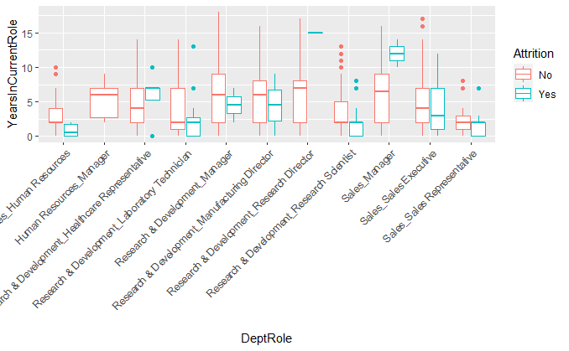
Top 3 Factors for Attrition
Years In Current Role vs Dept Role vs Attrition
Department
Role
Years in Current Role
Human Resources_Human Resources
Research & Development_HealthcareRepresentive

Slide 7
Attrition Model: Naïve Bayes Classifier
Factors Included in Model
Marital Status | Monthly Income
Over Time | Total Working Years
DeptRole* | Years In Current Role
Legacy* | StockOptionLevel
DistanceFromHome | YearsAtCompany
JobInvolvement | BusinessTravel
Results
Avg. Accuracy | 78%
Avg. Sensitivity | 65%
Avg. Specificity | 81%
*Derived column from dataset:
DeptRole = Department + Role
Legacy = YearsInCurrentRole*TotalWorkingYears*JobLevel*EnvironmentSatisfaction*MonthlyIncome*Age;
(will continue to monitor this metric throughout deployment)

Slide 8
Monthly Salary Model: Multiple Linear Regression
Factors Included in Model
Total Working Years | Business Travel
Job Level** | Job Role**
Results
R Squared | 0.954
Adj. R Squared | 0.953
Root Mean Sq. Error | 973.76
** Interactions were used for job level and job role

Slide 9
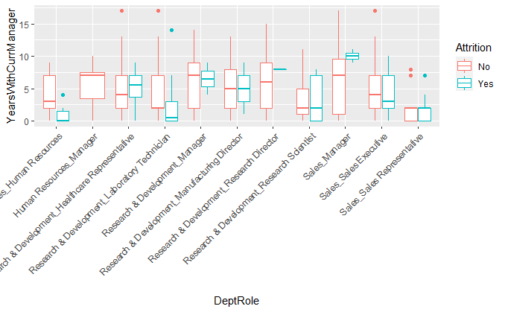
Managerial Trends:
Years With Current Manager vs Dept Role vs Attrition
Human Resources Department :
No attrition amongst managers
100% of non-manger who left, left within the first 5 years
Non managers, at 22%, have the second highest turnover rate
Human Resources_Human Resources
Research & Development_HealthcareRepresentive

Slide 10
Managerial Trends: (continued)
Years With Current Manager vs Dept Role vs Attrition
Sales Department:
All sales mangers who left, left after 8-12 years with their current manager
Sales Reps, at 45%, has the highest turnover rate
Human Resources_Human Resources
Research & Development_HealthcareRepresentive

Slide 11
Managerial Trends: (continued)
Years With Current Manager vs Dept Role vs Attrition
R&D Department:
All, but two of the 30 Lab Techs who left, left the company within first 5 years in their current role
Research Scientist ~20% and Lab Techs ~19% are have the third and fourth highest turnover rates
Human Resources_Human Resources
Research & Development_HealthcareRepresentive

Slide 12
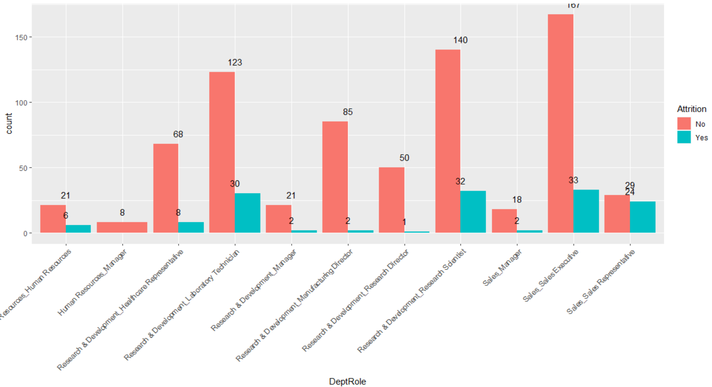
Managerial Trends: (continued)
Attrition Count vs Dept Role

Slide 13
Recommendations
Meet with the mangers, and a few employees in the areas where unfavorable trends were identified, to gain insight on why these trends are occurring
Meet with mangers, and a few employees of those mangers, with low turn over to capture any favorable insight that can be shared with the entire organization in efforts to help mitigate employee turnover

Slide 14
Summary
Department, Job Role and Years in Current Role, combined were the top 3 factors contributing to Turnover
The Turnover Model Achieved an accuracy of 74% for the given dataset
The mean Salary Model predictions can be expected to be within $1,000 of the true monthly salary
Sit down with managers and employees, in specified areas, to explore root cause of turnover in order to mitigate turnover

